Slide 1


Say GoodBye to Qs
1st Nov, 2021
Notes:
© DS School of Entrepreneurship, IIT Bombay

Slide 2

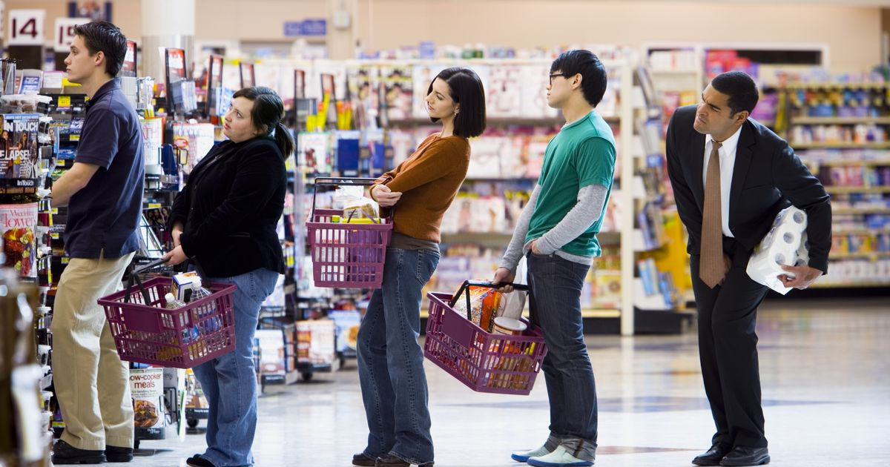
The Problem
Long queues at the checkout
Slow manual billing
Wasted manpower
Notes:
© DS School of Entrepreneurship, IIT Bombay

Slide 3
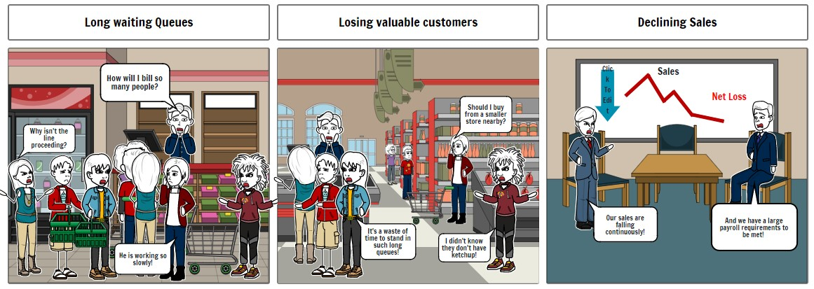
The Problem
Notes:
© DS School of Entrepreneurship, IIT Bombay

Slide 4
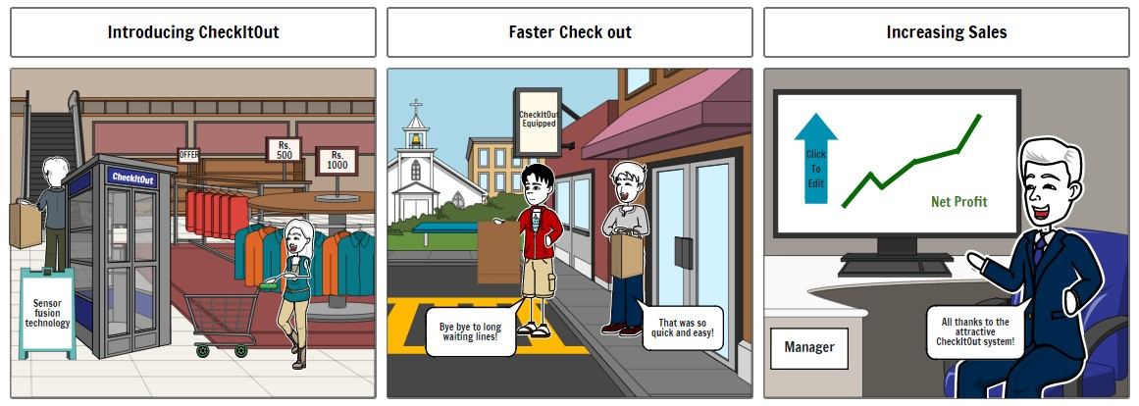
The Solution
Notes:
© DS School of Entrepreneurship, IIT Bombay

Slide 5
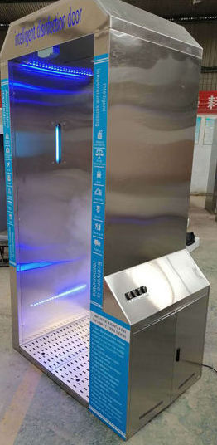
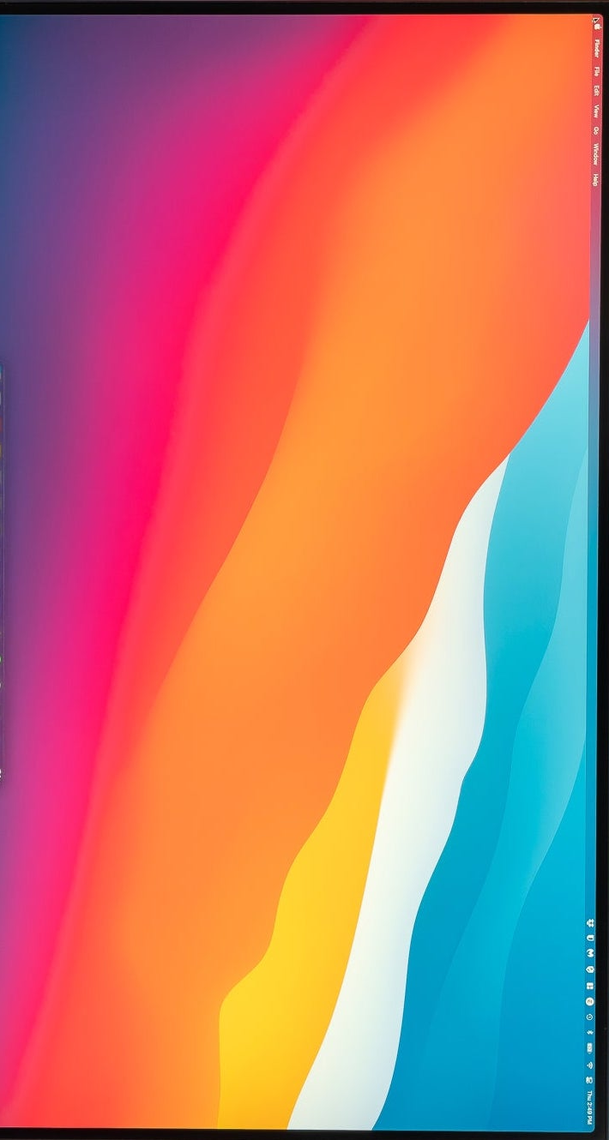
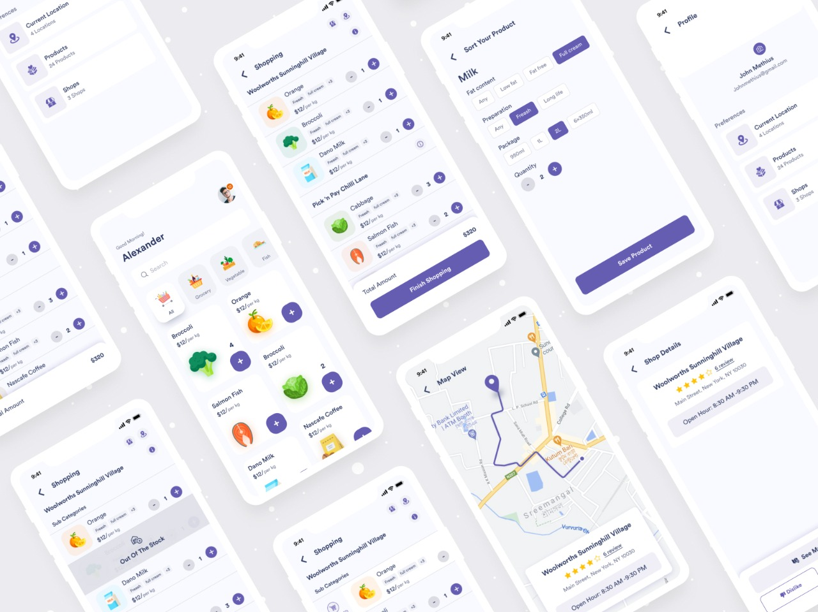
The Solution
The Checkout System: A full-sized bay-cabin installed at the exit of the store, equipped with AI Based object identification and billing system to boost the speed of checkout process.
Analytics: Robust data analytics provided to the store management regarding the purchase patterns and consumer behaviour to optimise the inventory to its peak
Mobile App: An all-in-one mobile app for the customers to verify their purchase and make payments on-the-go
Notes:
© DS School of Entrepreneurship, IIT Bombay

Slide 6



Value Proposition
No need to hire staff for billing and handling payments.
Drastically reduces wait times
Reduces human contact and error
Easy Inventory Management
Insightful Consumer Analytics
Notes:
© DS School of Entrepreneurship, IIT Bombay

Slide 7
Market Size
TAM
$4.6bn : Supermarkets and Stores Internationally
SAM
$1.2bn : Super & Hyper markets in Tier 1&2 cities of India
Z
SOM
$400mn : High-end Markets
Notes:
© DS School of Entrepreneurship, IIT Bombay

Slide 8
Competition
 | Normal shops | Online Shopping | Amazon Go like Store | Shops with CheckITOut
Shopping Experience | X |  | X | X
Contactless Shopping |  | X | X | X
Reduced Billing Time |  | X | X | X
Initial CapEx | None | C |  | X
Analytics and Insights |  |  | X | X
Notes:
© DS School of Entrepreneurship, IIT Bombay

Slide 9

Our Customers (Super and Hyper marts in Tier 1 and 2 Indian cities) were mostly willing to try, some felt the initial CapEx was too high
An Amazon-Go like store not practically feasible since it requires a large capital influx (> $200,000) on a yearly basis
Amazon-Go like stores
Dark stores
Our Customers: High End Supermarkets and Hypermarkets
Dark stores in India will not benefit from automation and only produce poor margins
We talked to a lot of our Consumers (users of said stores) who gave overall positive responses
A Conveyor-Belt based model rejected on the basis of poor management and time efficiency

Slide 10
Target Customers and Go To Market
Who are we targeting
High-end Supermarkets and Hypermarkets in Tier 1 and 2 Indian Cities.
Any retail outlet where people need to wait in queues.
How we plan to reach them
IIT Bombay’s extensive Alumni network
Trade Associations and Guilds
Social Media
Television
Website
Word of Mouth
Notes:
© DS School of Entrepreneurship, IIT Bombay

Slide 11
Financials
Financial SNAPSHOT - 5 YEARS
UNIT ECONOMICS | 2022 | 2023 | 2024 | 2025 | 2026 |  | 2022 - 26
REVENUE STREAM - 1 - STORES SUBSCRIPTION - SaaS MODEL
 |  |  |  |  |  |  | ₹ in Millions
No. of Stores | 7 | 13 | 22 | 30 | 50
REVENUE per STORE @ ₹ 1.50 lakhs per month (Subscription) | 12600000 | 23400000 | 39600000 | 54000000 | 90000000 |  | 219.60
Costs of Goods Sold (Direct COSTS) - includes UV Sensors, codes, back-end Data Management software etc. @ 40% of revenue | 5040000 | 9360000 | 15840000 | 21600000 | 36000000 |  | 87.84
GROSS MARGIN | 7560000 | 14040000 | 23760000 | 32400000 | 54000000 |  | 131.76
GM % age | 60.00 | 60.00 | 60.00 | 60.00 | 60.00 |  | 60.00
OVERHEADS + SG&A + Promoters' Time Spent @ 40% of Gross Margin | 3024000 | 5616000 | 9504000 | 12960000 | 21600000 |  | 52.70
DEPRECIATION [ No Borrowing - No Interest] @ 8% of Revenue | 1008000 | 1872000 | 3168000 | 4320000 | 7200000 |  | 17.57
Net Profit / Loss - Stores Software revenue stream | 3528000 | 6552000 | 11088000 | 15120000 | 25200000 |  | 61.49
Net Profit / Loss % age | 28.00 | 28.00 | 28.00 | 28.00 | 28.00 |  | 28.00
Notes:
© DS School of Entrepreneurship, IIT Bombay

Slide 12
Financials
UNIT ECONOMICS | 2022 | 2023 | 2024 | 2025 | 2026 |  | 2022 - 26
REVENUE STREAM - 2 - Subscribers (customers) of Platform - SaaS MODEL
 |  |  |  |  |  |  | ₹ in Millions
No. of Subscribers | 140000 | 260000 | 440000 | 600000 | 1000000 |  | 1000000
REVENUE per customer @ ₹200 / year - from Ads, sponsorship, promotions etc. with 5% esc. | 28000000 | 54600000 | 96800000 | 138000000 | 240000000 |  | 557.40
Costs of Social Marketing, goodies, promotions, Advertisements etc. @ ₹80/ customer/yr | 11200000 | 21840000 | 38720000 | 55200000 | 96000000 |  | 222.96
Development & Maintenance of platform, apps etc. @ 30% of revenue (2) | 8400000 | 16380000 | 29040000 | 41400000 | 72000000 |  | 167.22
GROSS MARGIN | 8400000 | 16380000 | 29040000 | 41400000 | 72000000 |  | 167.22
GM % age | 30.00 | 30.00 | 30.00 | 30.00 | 30.00 |  | 30.00
DEPRECIATION [ No Borrowing - No Interest] @ 8% of Revenue | 2240000 | 4368000 | 7744000 | 11040000 | 19200000 |  | 44.59
Net Profit / Loss - Customer platform subscription stream (2) | 6160000 | 12012000 | 21296000 | 30360000 | 52800000 |  | 122.63
Net Profit / Loss % age | 22.00 | 22.00 | 22.00 | 22.00 | 22.00 |  | 22.00
Net Profit / Loss of the Enterprise | 9688000 | 18564000 | 32384000 | 45480000 | 78000000 |  | 184.12
Corporate Income Tax @ 36% of PBT | 3487680 | 6683040 | 11658240 | 16372800 | 28080000 |  | 66.28
Profit After Tax | 6200320 | 11880960 | 20725760 | 29107200 | 49920000 |  | 117.83
TOTAL REVENUE From both streams | 40600000 | 78000000 | 136400000 | 192000000 | 330000000 |  | 777.00
₹ in Millions | 41 | 78 | 136 | 192 | 330 |  | 777
Net (after TAX) Profit / Loss % age | 15 | 15 | 15 | 15 | 15 |  | 15.17
CAC / year with escalation of 5 % YoY | 80 | 84 | 88 | 92 | 96 |  | 88
Net income per customer / year | 200 | 210 | 220 | 230 | 240 |  | 220
Customer Payback period | 2 1/2 months
LTV per customer - over 15 year period (net) - Undiscounted | 3300
Notes:
© DS School of Entrepreneurship, IIT Bombay

Slide 13
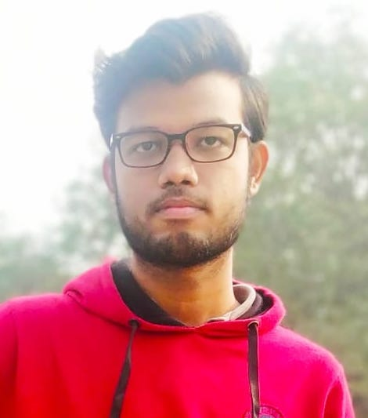
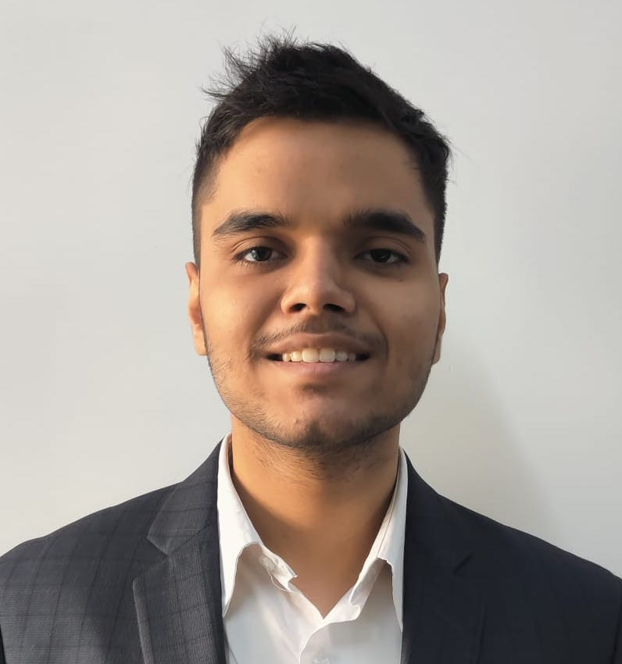
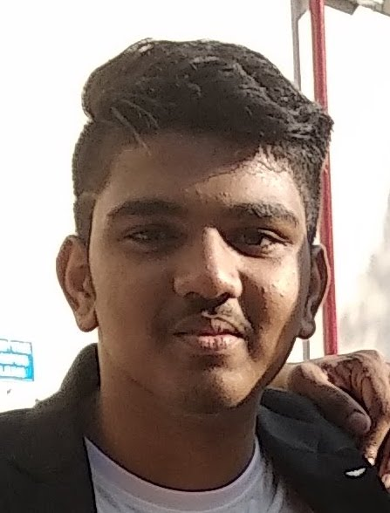
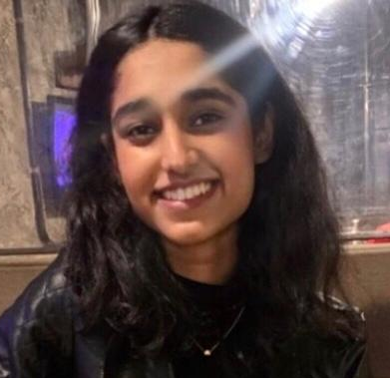
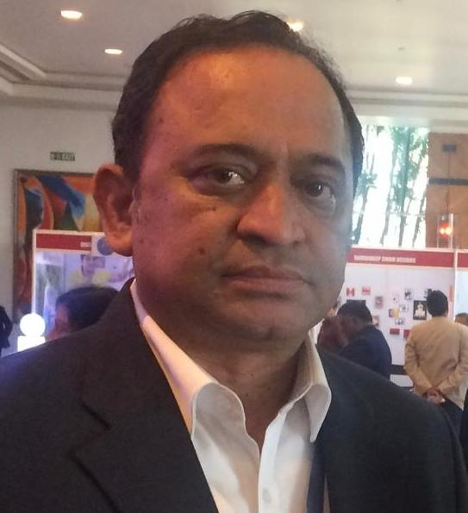
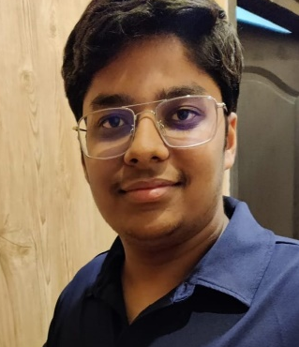
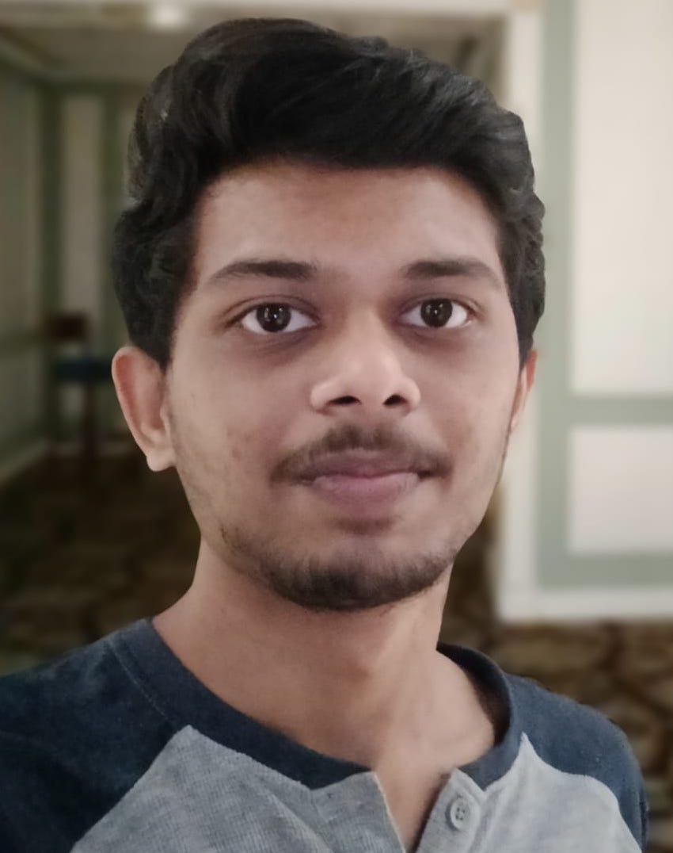
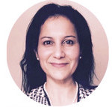
Team
Member Picture
Member Picture
Member Picture
Atul Verma
19B090004
3rd Year, Mathematics
ML and Computer Vision
Ayushman Choudhary
200020039
2nd Year, Chemical Engg. Web & App Development
P Balasubramanian
200050103
2nd Year, CSE
Machine Learning and AI
Mugdha Bajpayee
200100099
2nd Year, Mechanical Engg.
Tech and Development
Member Picture
Member Picture
Member Picture
Rangarajan R Iyengar
214278002
PhD – SJMSOM (IIT-B)
Management and Finance
Vidit Goel
200050156
2nd Year, CSE
Tech and Development
Vishruth N
200010088
2nd Year, Aerospace
Blockchain, ML
Mrs.Kanchan Dwivedi
Mentor
Founder, LoanGini
Notes:
© DS School of Entrepreneurship, IIT Bombay

